Slide 1

Change-Fever
Board game for pre-realese
Dávid Csizovszki
2016.03.16-17. Praha

Slide 2
Basics
Crisis of release: practical problems, like invalid ID, lack of tax number, increased chance for unemployment, financial difficulties.
VSA: Since 2002 VSA delivers courses to the target group, using games.
2010 Change-Fever pre-release board game.

Slide 3
Change-Fever pre-release boarding game
The board game as a method in pre-release training. In the beginning of the 2010’s we developed a board game specifically for pre-release courses.
  During the previous years the staff gathered enough experience to be able to plan and create an entertaining but also didactical game capable for being played in the special environment of a prison.
Similar to Monopoly
After its creation the structure of our pre-release courses changed.
  Run by the previous order, after that there is session for the game. This structure makes easier to repeat subjects and topics of the course without becoming redundant or boring. The board game goes through the main topics of the course again from a quite different aspect. Besides it helps to consider the special composition of the target group in question.

Slide 4
Requirements
  playfully
  didactic
  easily understandable

Slide 5
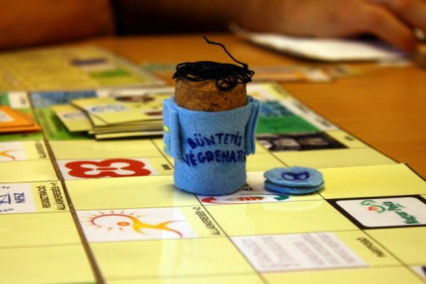
Aim/Content
  The first month:
    the necessary documents
    deal with housing and the costs of living
    hunt jobs
    challenge of self-sufficiency
    learn about benefits and face unexpected troubles
  Master
  100 % homemade

Slide 6
Playing the game
Preparation
In the game every inmates act themselves.
Data from the players:
  Number of children (each of them means additional expenses per day in Hungary it is 500 HUF≈2 EUR at the moment)
  Graduation (8 primary 1 point, secondary school or vocational training graduation means 2 points at job hunting)
  Number of years spent with work in prison (determines starting credit – each year 10 000 HUF≈30 EUR)
  Addictions (cigarette, alcohol, caffeine = 500-500 HUF ≈ 2 EUR a day/round)
  Accommodation (Homeless shelter costs 2000 HUF ≈ 6 EUR per month; half-way flat 10 000 HUF≈30 EUR + 5000 HUF≈15 EUR overhead; rented flat 50 000 HUF ≈160 EUR + 15 000≈50 EUR overhead)
After that players get their starting credit according to the given data.

Slide 7
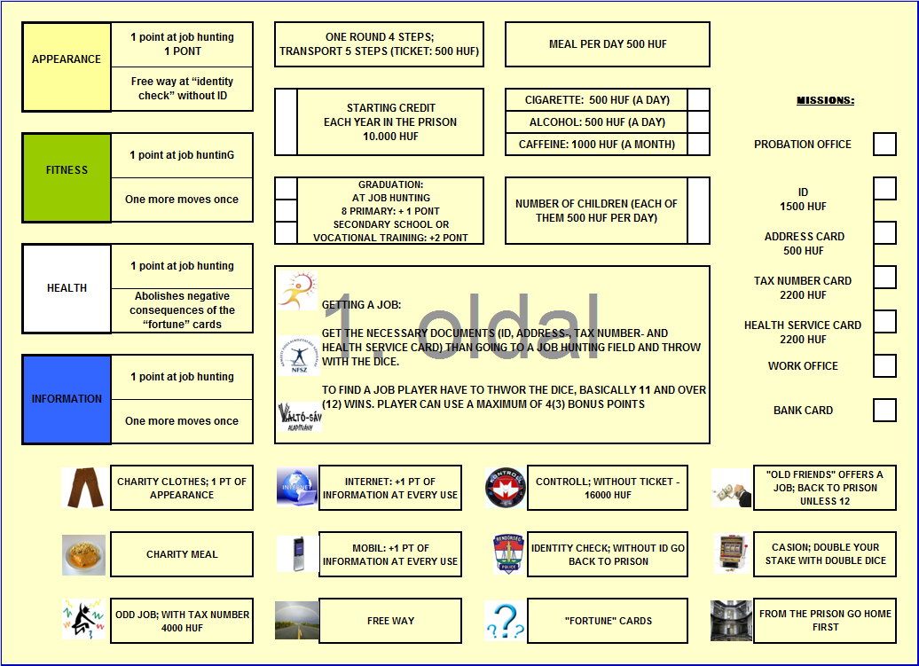

Slide 8
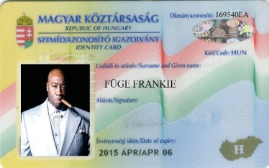
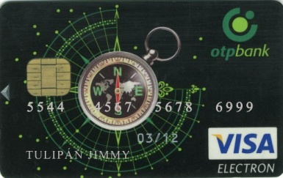
Introduction to the game
Just like as in RPG (role-playing game), the game starts with a “telling in the tale”.
The game master introduces the game, highlight the real aim of it. Players can use the previously acquired information, practice everyday life, face with problems that are probably waiting for them out of the prison. This is a good chance for them to see, in this stage of their preparation, what they could achieve.
Missons:
  If necessary go to the probation officer
  Acquire all necessary documents
  Find a job
  Create a bank account
  Pay all expenses
  To finish the game in the best possible financial situation

Slide 9
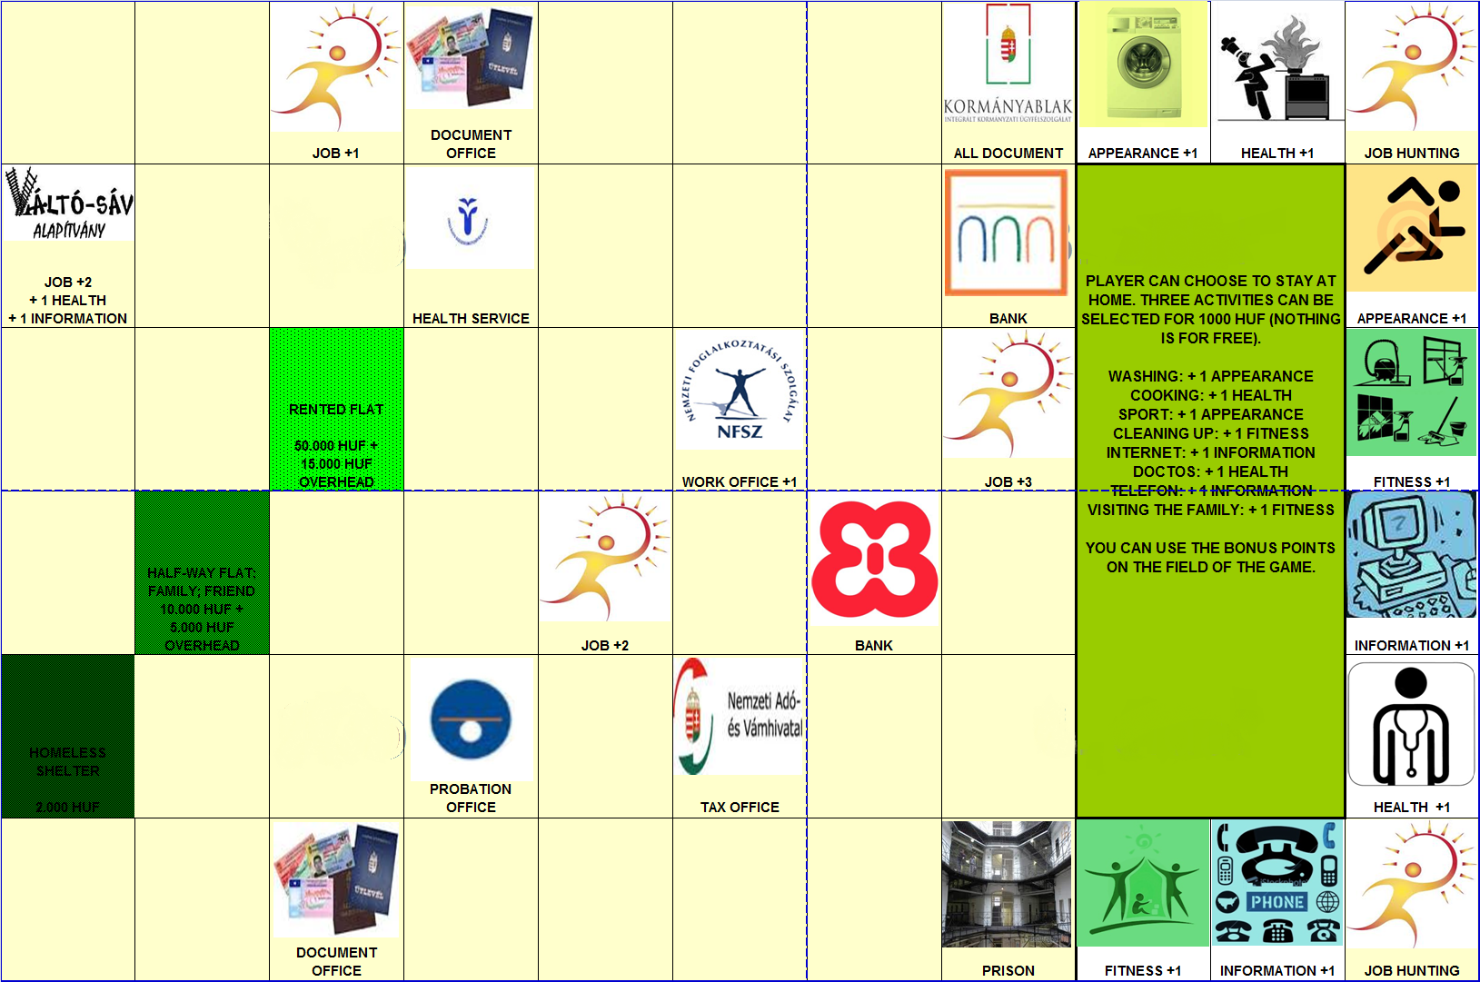
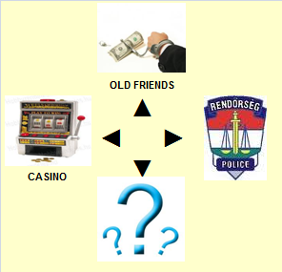
Gameplay
In underground transitions and in stopping place forbidden to smoke. However you did that. Pay 5000 HUF≈16 EUR!
Steps
1.
2.
1.
2.
3.
3.

Slide 10
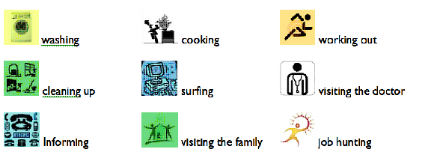
Stay at home
Several activities
Reward with bonus points

Slide 11




Getting a job
All personal documents (ID, address-, tax-, healthcard,)
Several fields on the board
11 or 12
+
+
Use bonus (max 4)
7

Slide 12
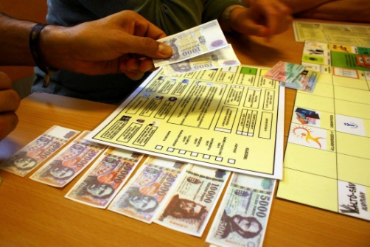
Nothing for free
  Deal with housing and the costs of living
Pay for
  The documents (e.g.: ID – 2500 HUF ≈ 8 EUR)
  Addictions (cigarette, alcohol, caffeine = 500-500 HUF ≈ 2 EUR /day/round)
  Meals (500 HUF ≈ 2 EUR /day/round)
  After the family member (500-500 HUF ≈ 2 EUR /day/round )
  Transport (ticket costs 500 HUF ≈ 2 EUR or monthpass 9500 HUF ≈ 30 EUR )
  Accomodation, overhead (e.g.: rented flat 50 000 HUF ≈ 160 EUR + 15 000 ≈ 50 EUR overhead)
  „Fortune” cards (unexpected troubles)

Slide 13

End of the game
Necessarily there is no winner.
As finding a legal job is the key element of successful re-entry, it must worth the most.
Master collects the dues of the players, and lists the credits and the accomplished missions of them.
  Best possible financial situation

Slide 14
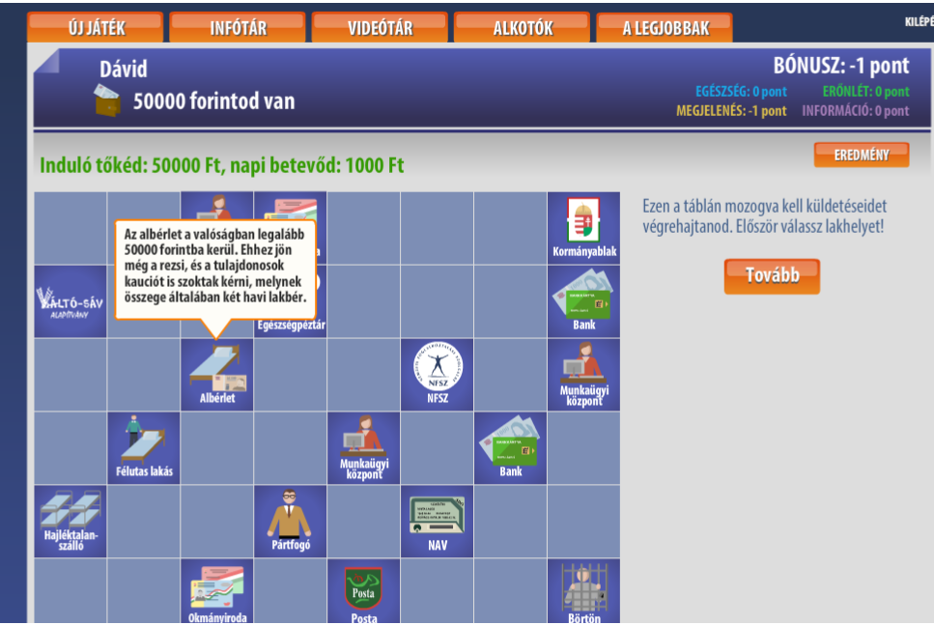
Digital version
In the frame of a later EU grant we managed to elaborate the digital version.
Aim, content, methods the game is similar to the board game version.
No master, rather short videos and pop-ups.
Challenges/disadvantages:
  the digital version (an individual game, no possibility for multiplayer mode thus cooperation and interaction is excluded)
  No master
  greatly strengthens the IT competence of the target group
  The use of the IT cabinet (if exists) of a prison is problematic.
  The playing time is much shorter than the board game version.
See you in O3

Slide 15
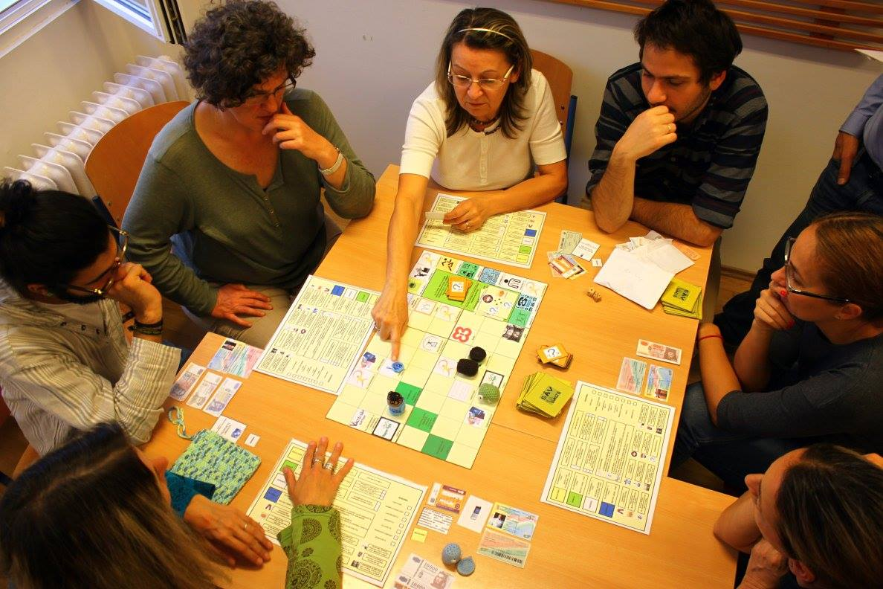
Experiences
A great challenge. Prison means random composition of target group (dropout, transport, etc.), incalculable time for session (time of check in and out of the prison depends on several conditions), difficulty in learning the rules.
The game has changed a lot since its creation, but the game’s architecture makes it easy to adjust it to reality.
  New elements became, old got out.
  Prices, legal norms, sum of fines, names of offices etc.
It is always the most exciting, most amusing part of pre-release courses organised for the target group.
Antidiscrimination workshops to student, high school students or employers, use the boarding game.

Slide 16
Thank you for your attention
Dávid Csizovszki
david.csizovszki@gmail.com
Váltó-sáv Foundation

